Slide 1

Millennials
Image credit www.entrepreneur.com

Slide 2

Introduction
Are you a millennial?
What do you think the typical characteristics of a millennial are?
MILLENNIALS

Slide 3
TRUE OR FALSE?
Millennials are the generation born in the 80s and 90s that reached young adulthood in the early 21st century.
Millennials are also known as Generation (Gen) Z.
This generation is most likely to live at home with their parents.
This generation is more interested in sport than the previous generation.
They are considered more politically correct or ‘woke’ than previous generations.
MILLENNIALS

Slide 4
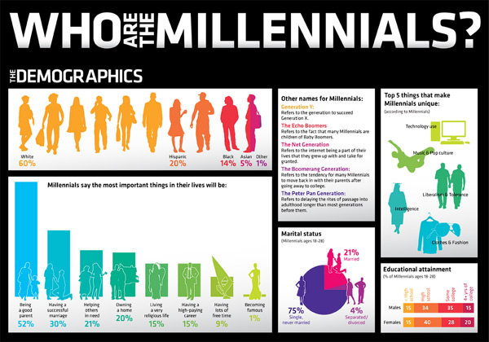
https://theberkshireedge.com/connections-8/

Slide 5
TRUE OR FALSE?
Millennials are the generation born in the 80s and 90s that reached young adulthood in the early 21st century. – TRUE (1980 -1994)
Millennials are also known as Generation (Gen) Z. - FALSE = GEN ‘Y’
This generation is likely to live at home with their parents.- TRUE (Peter Pan generation/delayed rites of passage)
This generation is more interested in sport than the previous generation. – FALSE (Gen. X 45% - Gen. Y – 38%)
They are considered more politically correct or ‘woke’ than previous generations. - TRUE (e.g. anti-Brexit/Trump statistics)
MILLENNIALS

Slide 6
The following words have been used to describe millennials. Do you agree or disagree?
entitled
narcissistic
lazy
spoiled
selfish
generous
confident
tolerant
tech-savvy
politically-aware
Generation Me, Jean Twenge, 2006
MILLENNIALS

Slide 7















Millennials are sometimes described as the ‘Internet generation’. How many of these icons and symbols can you identify?

Slide 8
ALANIS MORISSETTE: IRONIC
It’s like rain ....
It’s a black fly ....
It’s a free ride ....
A traffic jam ....
A no-smoking sign ....
It’s like 10,000 spoons ....
MILLENNIALS

Slide 9
ALANIS MORISSETTE: IRONIC
It’s like rain ....
It’s a black fly ....
It’s a free ride ....
A traffic jam ....
A no-smoking sign ....
It’s like 10,000 spoons ....
... on your cigarette break
... in your chardonnay
... when all you need is a knife
... when you’ve already paid
... when you’re already late
... on your wedding day
MILLENNIALS

Slide 10
ALANIS MORISSETTE: IRONIC
It’s like rain ....
It’s a black fly ....
It’s a free ride ....
A traffic jam ....
A no-smoking sign ....
It’s like 10,000 spoons ....
... on your wedding day
... in your chardonnay
... when you’ve already paid
... when you’re already late
... on your cigarette break
... when all you need is a knife
MILLENNIALS

Slide 11
ALANIS MORISSETTE
IRONIC (FOR MILLENNIALS)
Match...
It’s like swiping left ....
It’s like Netflix ....
It’s a Snapchat....
A traffic jam ....
It’s a funny tweet ....
It’s like Amazon ....
... that you wish you had saved
... but you own DVDs
... but your package never came
... when you try to use waze
... that nobody faves
... on your future soulmate
MILLENNIALS

Slide 12

MILLENNIALS

Slide 13
Follow-up questions
Are the situations described in the song really ironic?
Morissette suggests there are thousands of late-night (TV talk show) hosts. Why are there so few women in this role?
What do you think the characteristics of the next generation (Gen Z) are going to be?
What questions would you ask a member of Gen Z?
MILLENNIALS

