Slide 1


Slide 2
.
Instructions
- In this game, the teacher will show you some questions or images.
- The answers are always phrases of two or more words BUT you must give the words in alphabetical order, e.g.
The United States = States The United
- The first person to write the correct answer in the chat box wins the point.

Slide 3
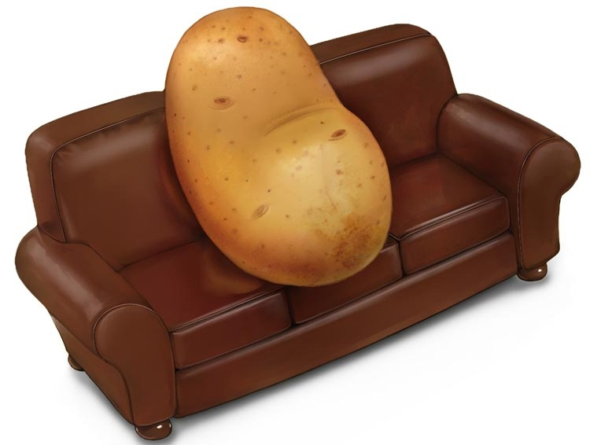
image credit: thesportsexaminer.com
IDIOMS FOR PEOPLE

Slide 4
IDIOMS FOR PEOPLE
COUCH POTATO

Slide 5

image credit: britannica.com
IDIOMS FOR PEOPLE

Slide 6
IDIOMS FOR PEOPLE
CANNON LOOSE
(LOOSE CANNON)

Slide 7
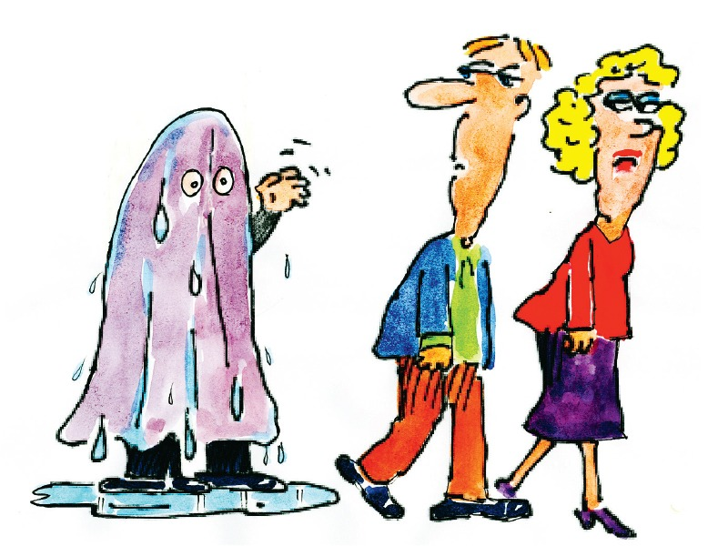
image credit:
https://archive.ceylontoday.lk/features-more/3920
IDIOMS FOR PEOPLE

Slide 8
IDIOMS FOR PEOPLE
BLANKET WET
(WET BLANKET)

Slide 9
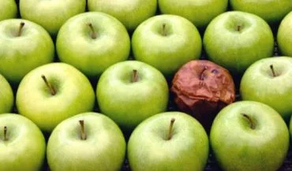
Image credit: exploringyourmind.com
IDIOMS FOR PEOPLE

Slide 10
IDIOMS FOR PEOPLE
APPLE ROTTEN
(ROTTEN APPLE)

Slide 11
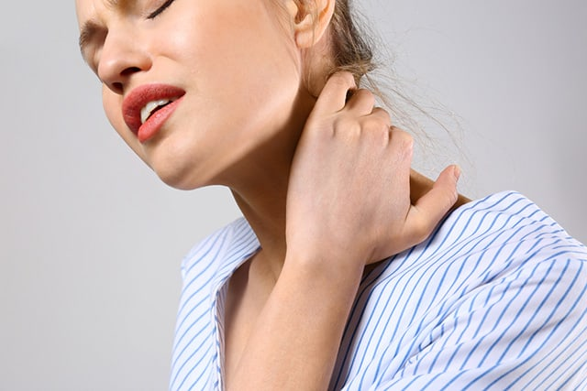
Image credit: limitlesstherapyandwellness.com
IDIOMS FOR PEOPLE

Slide 12
IDIOMS FOR PEOPLE
A IN NECK PAIN THE
(A PAIN IN THE NECK)

Slide 13

Image credit: dictionaryblog.cambridge.org
IDIOMS FOR PEOPLE

Slide 14
IDIOMS FOR PEOPLE
AND LIFE OF PARTY SOUL THE THE
(THE LIFE AND SOUL OF THE PARTY)

Slide 15
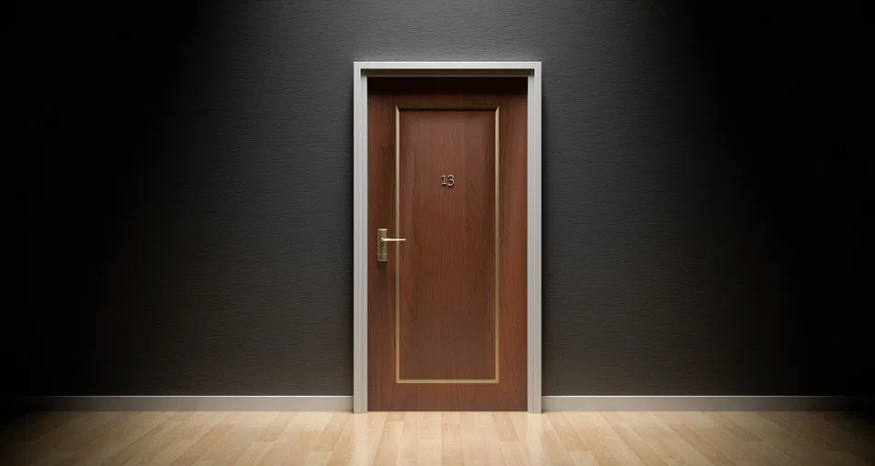
Image credit: markdouglasdoran.com
IDIOMS: SECRETS

Slide 16
IDIOMS: SECRETS
BEHIND CLOSED DOORS

Slide 17
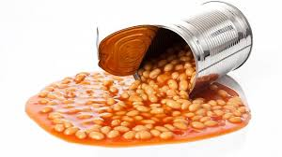
Image credit: busy.org
IDIOMS: SECRETS

Slide 18
IDIOMS: SECRETS
BEANS SPILL THE TO
(TO SPILL THE BEANS)

Slide 19
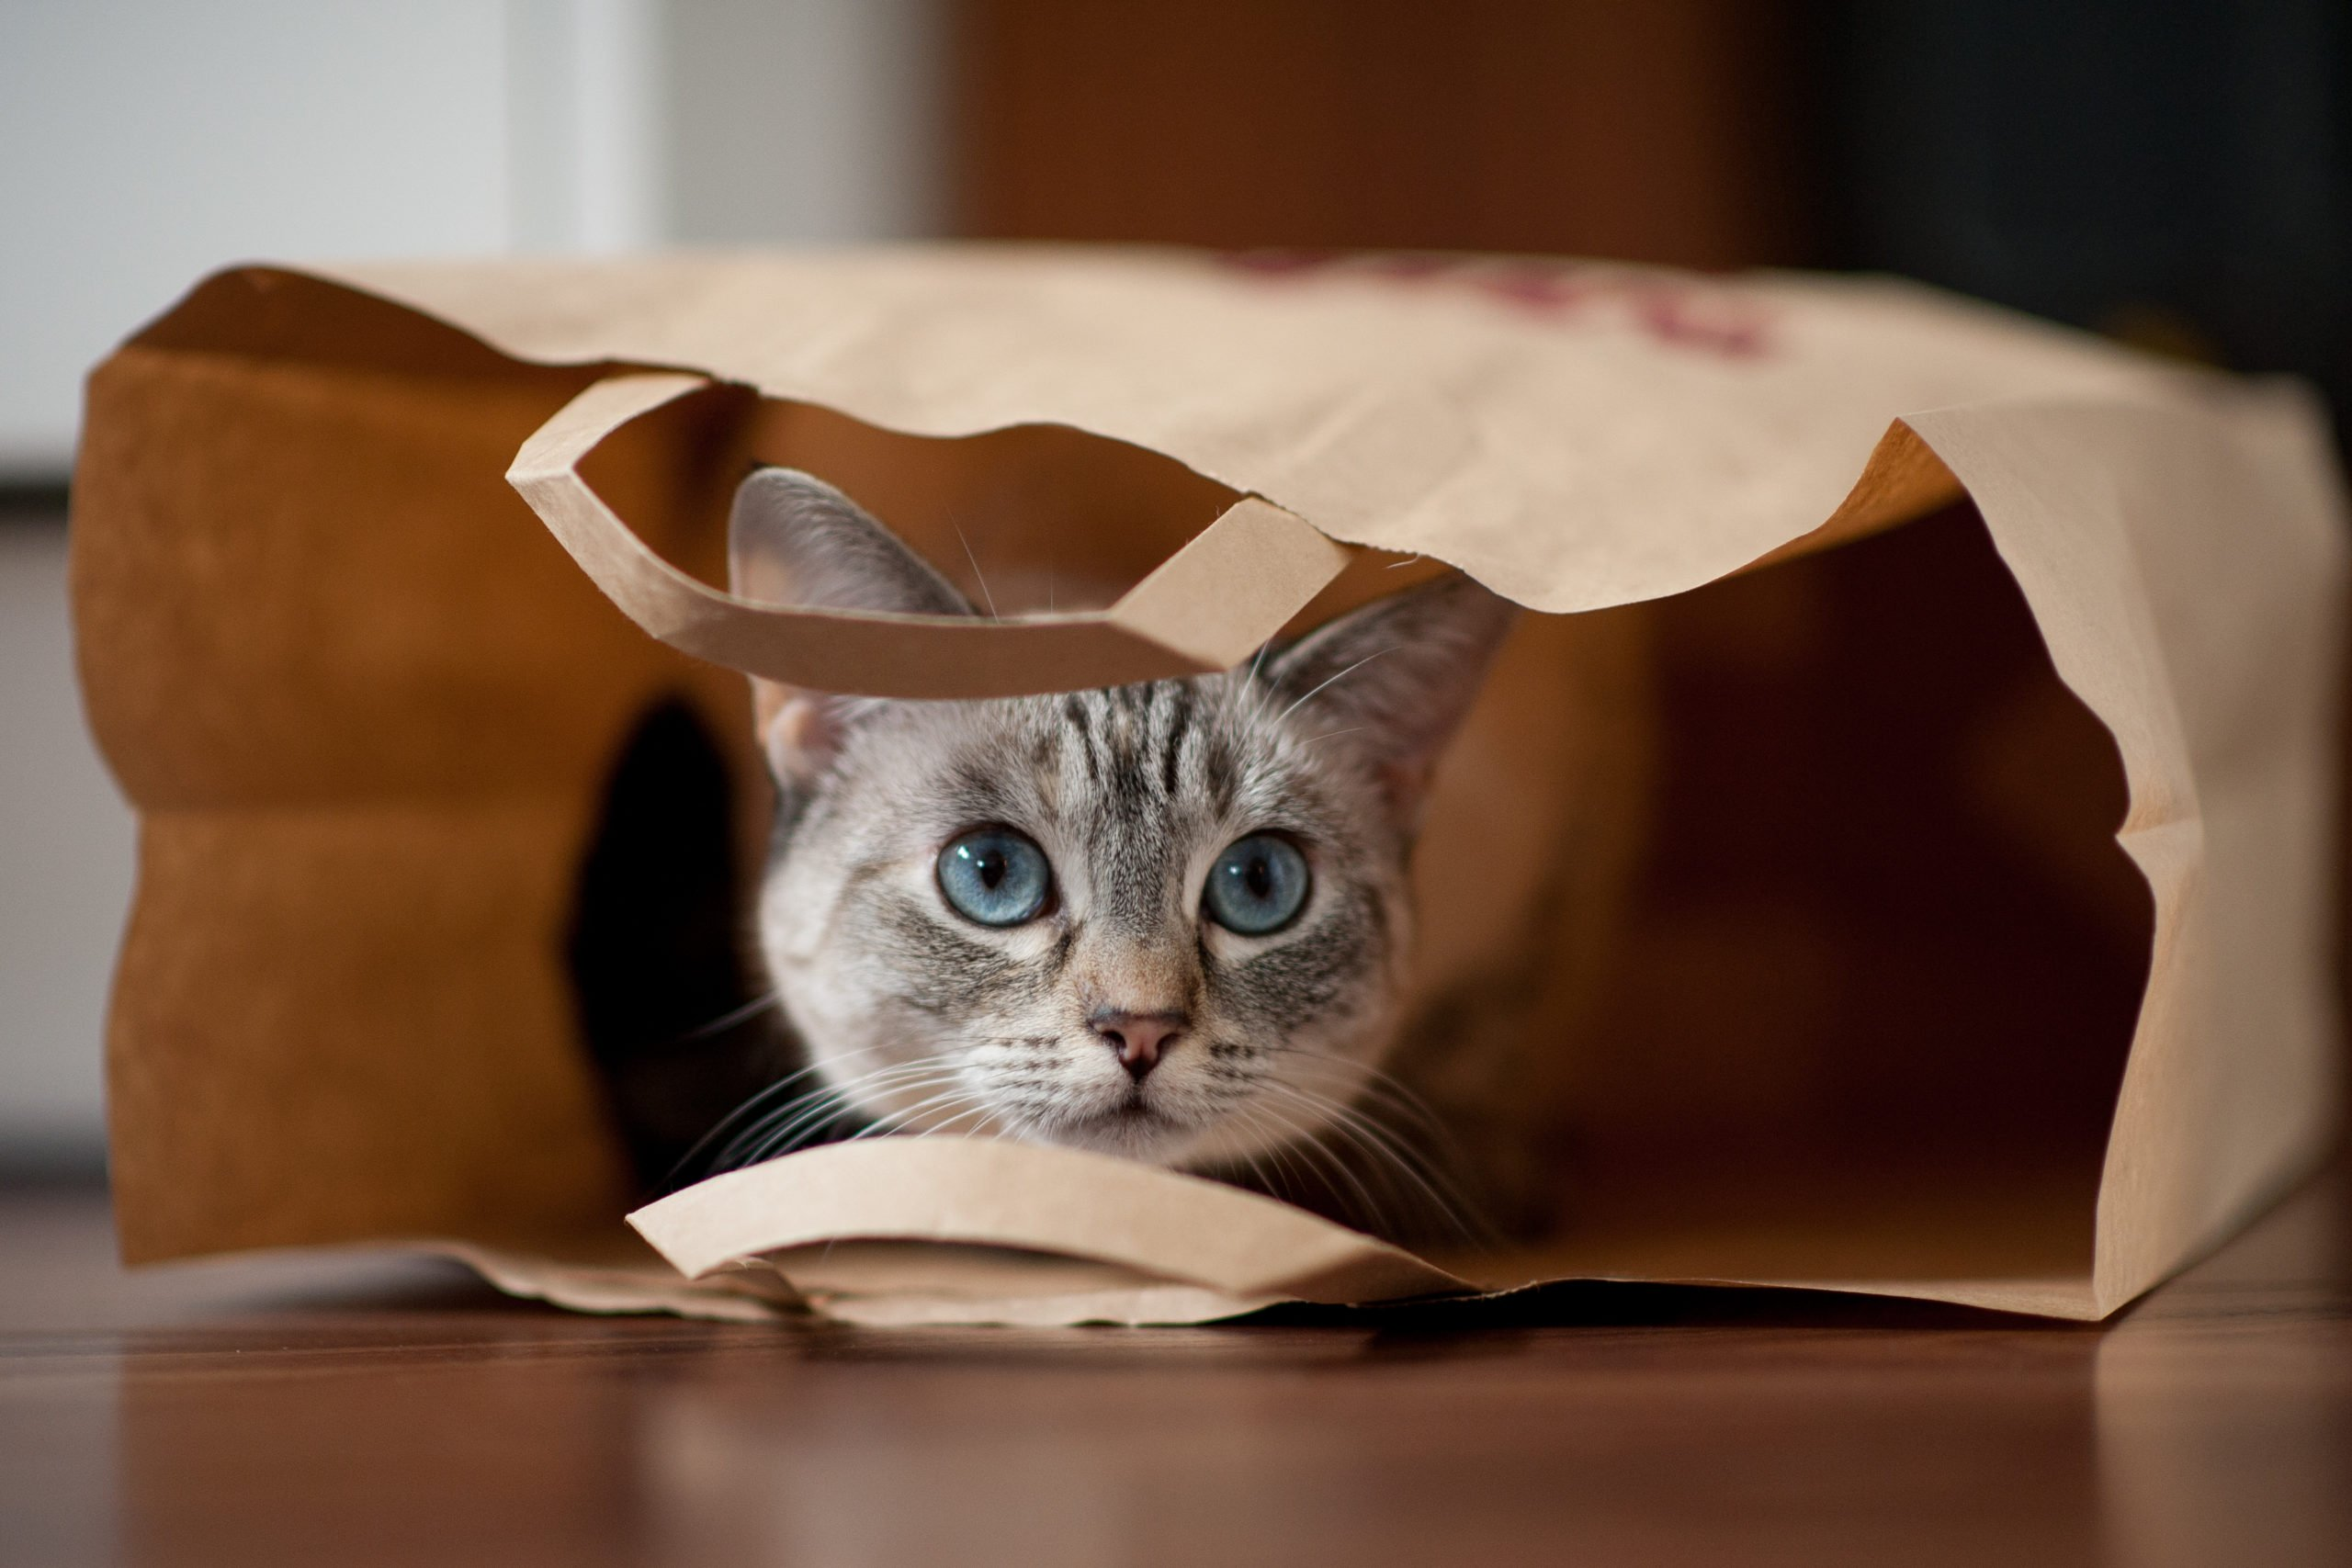
Image credit: rd.com
IDIOMS: SECRETS

Slide 20
IDIOMS: SECRETS
BAG CAT LET OF OUT THE THE TO
(TO LET THE CAT OUT OF THE BAG)

Slide 21

Image credit: goodfon.com
IDIOMS: RELAXING

Slide 22
IDIOMS: RELAXING
BURN MIDNIGHT OIL THE TO
(TO BURN THE MIDNIGHT OIL)

Slide 23

Image credit: jchscaldron.com
IDIOMS: RELAXING

Slide 24
IDIOMS: RELAXING
DOWN HAIR LET TO YOUR
(TO LET YOUR HAIR DOWN )

Slide 25

Image credit: nytimes.com
IDIOMS: RELAXING

Slide 26
IDIOMS: RELAXING
A BREATHER HAVE TO
(TO HAVE A BREATHER)

Slide 27

Image credit: iconexperience.com
IDIOMS: RELAXING

Slide 28
IDIOMS: RELAXING
OFF SWITCH TO
(TO SWITCH OFF)

Slide 29
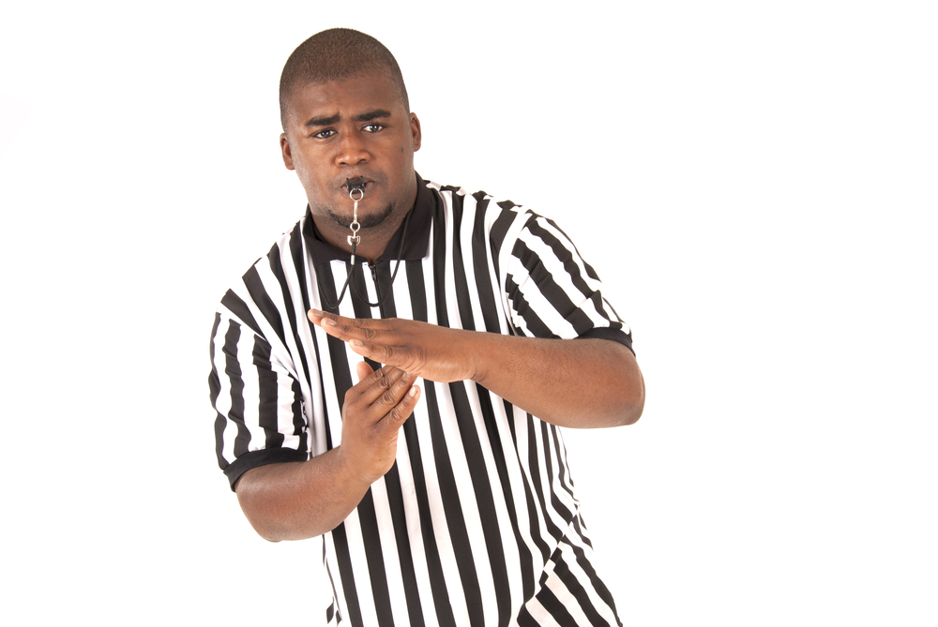
Image credit: collinsdictionary.com
IDIOMS: RELAXING

Slide 30
IDIOMS: RELAXING
OUT TAKE TIME TO
(TO TAKE TIME OUT)

