Slide 1


Slide 2
Instructions
- This is a game for pairs
- The teacher will ask you all a question.
- The first student to answer it correctly
wins the question BUT.....
- Your partner has to spell it correctly to win
the point

Slide 3
Someone who always does their work well and on time is very....
R..........

Slide 4
Someone who always does their work well and on time is very....
RESPONSIBLE

Slide 5

I
What is this person doing?
Image credit: oxfordlearning.com

Slide 6
S.......
What is this person doing?

Slide 7
STUDYING
What is this person doing?

Slide 8
A modal verb expressing prohibition
M......

Slide 9
A modal verb expressing prohibition
MUSTN’T

Slide 10

What is she doing?

Slide 11
W......
What is she doing?

Slide 12
WRITING
What is she doing?

Slide 13
A........
To take ............................of a situation

Slide 14
ADVANTAGE
To take ............................of a situation

Slide 15
F.....
Someone you enjoy spending time with

Slide 16
FRIEND
Someone you enjoy spending time with

Slide 17

What is this?

Slide 18
BICYCLE
What is this?

Slide 19
What relative pronoun is missing?
WHAT, WHERE, WHEN, ............, WHO, etc

Slide 20
WHICH
What relative pronoun is missing?
WHAT, WHERE, WHEN, ............, WHO, etc

Slide 21

This is a picture of a .................... room
Image credit: www.1stopbedrooms.com

Slide 22
DINING
This is a picture of a .................... room

Slide 23
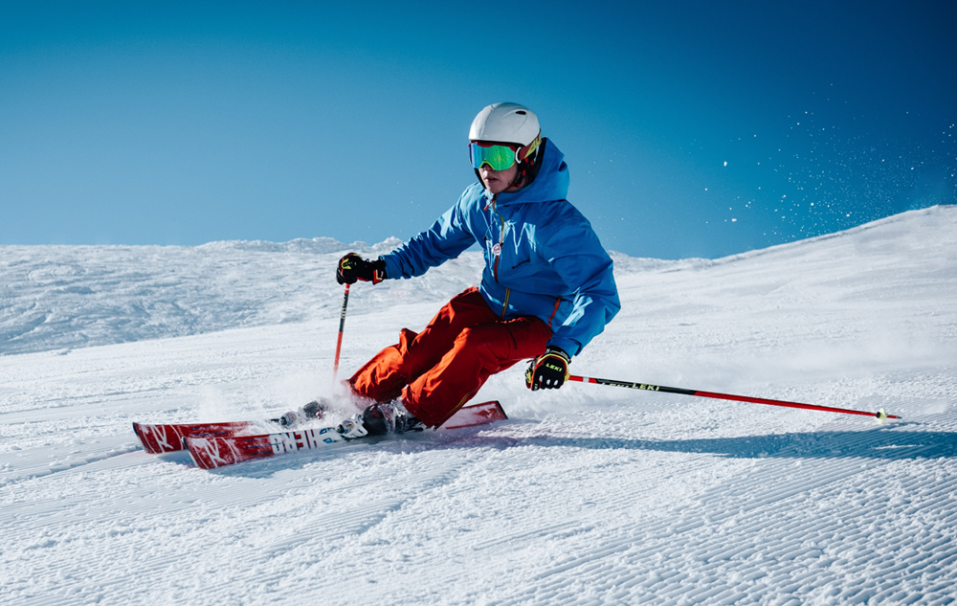
What is this sport?
Image credit: www.dreampeaks.com

Slide 24
SKIING
What is this sport?

Slide 25

What is this shop called?

Slide 26
PHARMACY
What is this shop called?

Slide 27
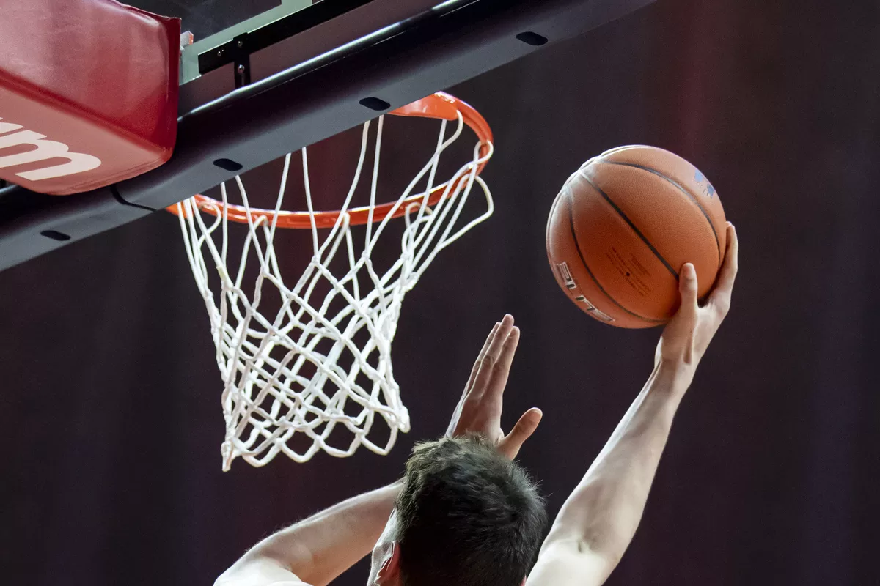
What game is this?

Slide 28
BASKETBALL
What is this game?

